Slide 1
Software Quality Assurance and Testing Technology
2nd Semester, Spring 2022
Haiming Liu
School of Software Engineering
Beijing Jiaotong University

Slide 2
考试内容
简答题
大题一（等价类划分，边界值分析，参考作业2）
大题二（Basis path test ，参考作业2 ）
全英文答卷
考试要求参看最新版文档

Slide 3
What is Testing
Software testing is a process, or a series of processes, designed to make sure computer code does what it was designed to do and, conversely, that it does not do anything unintended.
System
Input
Output

Slide 4

Introduction
Fault, Error & Failure
Software Fault : A static defect in the software (i.e., defect)
Software Error : An incorrect internal state that is the manifestation of some fault
Software Failure : External, incorrect behavior with respect to the requirements or other description of the expected behavior

Slide 5
Introduction
PIE（Propagation-Infection-Execution） Model
Execution/Reachability : The location or locations in the program that contain the fault must be reached
Infection : The state of the program must be incorrect
Propagation : The infected state must propagate to cause some output of the program to be incorrect
Fault
Error
Failure

Slide 6
Introduction
Fault
public static void CSta (int [ ] numbers)
{
int length = numbers.length;
double mean, sum;
sum = 0.0;
for (int i = 1; i < length; i++)
{
sum += numbers [ i ];
}
mean = sum / (double) length;
System.out.println ("mean: " + mean);
}
Test Input: [3,4,5]
Error
Execution
sum=3+4+5
Infection
sum=4+5
mean=4
Propagation
mean=3
Failure

Slide 7
Introduction
A test executing the fault may not produce an error!
public static void CSta (int [ ] numbers)
{
int length = numbers.length;
double mean, sum;
sum = 0.0;
for (int i = 1; i < length; i++)
{
sum += numbers [ i ];
}
mean = sum / (double) length;
System.out.println ("mean: " + mean);
}
Test Input: [0,4,5]
sum=0+4+5
sum=4+5
Not an error for “sum”
mean=3
mean=3

Slide 8
Introduction
An error may not be propagated to the output!
Fault
public static void CSta (int [ ] numbers)
{
int length = numbers.length-1;
double mean, sum;
sum = 0.0;
for (int i = 0; i < length; i++)
{
sum += numbers [ i ];
}
mean = sum / (double) length;
System.out.println ("mean: " + mean);
}
Test Input: [3,5,4]
Error
sum=3+5+4
sum=3+5
mean=12/3=4
mean=8/2=4
No Failure
8

Slide 9
Introduction
Sources of Problems
Requirements Definition: Erroneous, incomplete, inconsistent requirements.
Design: Fundamental design flaws in the software.
Implementation: Mistakes in chip fabrication, wiring, programming faults, malicious code.
Support Systems: Poor programming languages, faulty compilers and debuggers, misleading development tools.

Slide 10
Introduction
Sources of Problems (Cont’d)
Inadequate Testing of Software: Incomplete testing, poor verification, mistakes in debugging.
Evolution: Sloppy redevelopment or maintenance, introduction of new flaws in attempts to fix old flaws, incremental escalation to inordinate complexity.

Slide 11
Introduction
Most bugs are not because of mistakes in the code …
Specification (~= 55%)
Design (~= 25%)
Code (~= 15%)
Other (~= 5%)

Slide 12
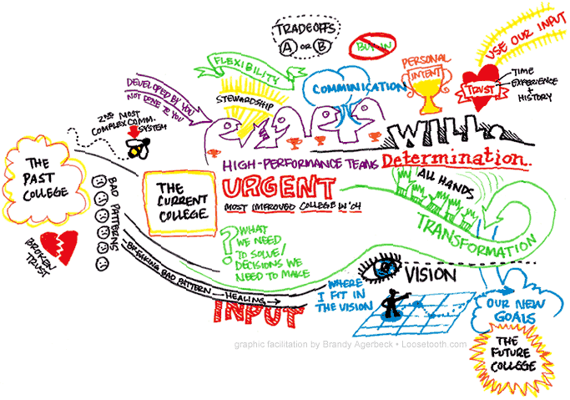
Principle of Testing
Specification（SPEC）
“if you can’t say it, you can’t do it”
not written.
not thorough enough.
constantly changing.
not communicated to the entire team in a timely manner.

Slide 13
Introduction
Specification “if you can’t say it, you can’t do it”
You have to know what your product is before you can say if it has a bug.
A specification defines the product being created and includes:
Functional requirements that describes the features the product will support. E.g., on a word processor
Save, print, check spelling, change font, …
Non-functional requirements are constraints on the product. E.g,
Security, reliability, user friendliness, platform, …

Slide 14
Introduction
A software bug occurs when at least one of these rules is true
The software does not do something that specification says it should do.
The software does something that specification says it should not do.
The software does something that the specification does not mention.
The software does not do something that the specification does not mention but should.
The software is difficult to understand, hard to use, slow, or in the software tester's eyes will be viewed by the end user as just plain not right.

Slide 15
Introduction
Goal of a software tester
… to find bugs
… as early in the software development processes as possible
… and make sure they get fixed.
Advice: Be careful not to get caught in the dangerous spiral of unattainable perfection.

Slide 16
DEBUGGING vs. TESTING
TESTER DEBUGGER
Developer Developer
Test team Analyst
QA team
End user
THERE IS A FUNDAMENTAL CONFLICT BETWEEN THESE ROLES

Slide 17
TESTING
The operation of a system or application under controlled conditions and the evaluation of results with the intent of finding errors.
Should include normal and abnormal conditions
Testing intentionally attempts to make things go wrong to determine:
if things happen when they shouldn’t
if things don’t happen when they should
Oriented towards “detection”

Slide 18
DEBUGGING
DEBUGGING starts with an identified error and is the process of locating what is causing the bug and correcting the flaw.
It is NOT the process of showing that a bug exists.
Oriented towards “correction”.

Slide 19
VERIFICATION
The process of evaluating a system or component during the development process to determine whether it satisfies the specifications.
THE CRITICAL QUESTION IS:
- Did we build what we planned to build?
Typically involves reviews and meetings to evaluate:
documents
plans
code
requirements
specifications

Slide 20
VALIDATION
The process of evaluating a system or component during the development process to determine whether it satisfies the user's requirements
THE CRITICAL QUESTION IS
“Did we build what the user wanted?”

Slide 21


Verification vs. Validation
Verification confirms that the software meets its specification.
- Are we building the product right？
Validation confirms that the software meets the user’s requirements.
- Are we building the right product ?
Never assume the specifications are correct when testing, Both V&V tests must be performed.
Example: The Hubble Space mirror was ground incorrectly (because the specs were wrong) and, consequently, it failed to produce clear pictures when originally launched.

Slide 22
Principle of Testing
Software process models are an ideal … not reality
No software development effort follows a process model perfectly. Why?
The specification never corresponds to the customers needs perfectly.
There is never enough time to perform all of the testing.
Nevertheless, an ideal model is helpful to make progress.
Trade offs and concessions are inevitable.

Slide 23
Principle of Testing
Software testing axioms
It is impossible to test a program completely.
Software testing is a risk-based exercise.
Testing cannot show the absence of bugs.
The more bugs you find, the more bugs there are.
Not all bugs found will be fixed.
It is difficult to say when a bug is indeed a bug.
Specifications are never final.
Software testers are not the most popular members of a project.
Software testing is a disciplined and technical profession.

Slide 24
Principle of Testing
Parenthesis: What is an axiom anyway?
An axiom is a sentence or proposition that is not proved or demonstrated and is considered as obvious or as an initial necessary consensus for a theory building or acceptation.
Therefore, it is taken for granted as true, and serves as a starting point for deducing and inferring other (theory dependent) truths.

Slide 25
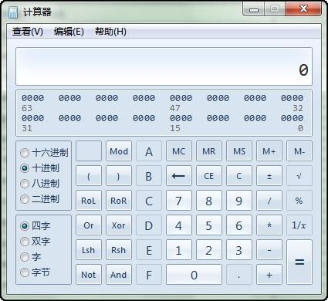
Principle of Testing
Axiom 1 It is impossible to test a program completely
How many test cases do you need to exhaustively test:
Powerpoint
A calculator
MS Word
Any interesting software!
The only way to be absolutely sure software works is to run it against all possible inputs and observe all of its outputs …
Oh, and the specification must be correct and complete.

Slide 26
Principle of Testing
Axiom 1 (cont’d) It is impossible to test a program completely
The number of possible inputs is very large.
The number of possible outputs is very large.
The number of paths through the software is very large.
The software specification open to interpretation.

Slide 27
Principle of Testing
Axiom 2 Software testing is a risk-based exercise
If you do not test the software for all inputs (a wise choice) you take a risk.
Hopefully you will skip a lot of inputs that work correctly.
What if you skip inputs that cause a fault?
Risk: financial loss, security, loss of money, loss of life!
That is a lot of pressure for a tester!
This course is all about techniques and practices to help reduce the.

Slide 28
Principle of Testing
Axiom 2 (cont’d) Software testing is a risk-based exercise
If you try to test too much, the development cost becomes prohibitive.
If you test too little, the probability of software failure increases and as we discussed … software failures can cost us big time!
Number of
Missed Bugs
Cost of
Testing
number
Under
Testing
Testing
Equilibrium
Over
Testing
Amount of Testing

Slide 29
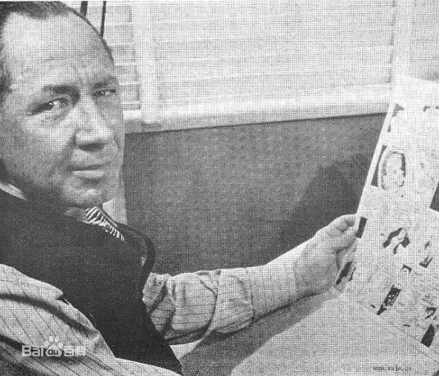
Principle of Testing
Axiom 2 (cont’d) Software testing is a risk-based exercise What about Murphy’s Law?
"If there's more than one possible outcome of a job or task, and one of those outcomes will result in disaster or an undesirable consequence, then somebody will do it that way.”
The law's name stems from an attempt to use new measurement devices developed by one Edward Murphy.

Slide 30

Principle of Testing
Axiom 3 Testing cannot show the absence of bugs
“Program testing can be used to show the presence of bugs, but never to show their absence!” - Edsger Wybe Dijkstra
Dijkstra received the 1972 ACM Turing Award for fundamental contributions in the area of programming languages

Slide 31

Principle of Testing
Axiom 4 The more bugs you find, the more bugs there are
Bugs appear in groups, where you see one you will likely find more … Why?
Programmers can have bad days
Programmers tend to make the same mistakes
Some bugs are just the tip of the iceberg.
Boris Beizer coined the term pesticide paradox to describe the phenomenon that the more you test software the more immune it becomes to your test cases.
Remedy: continually write new and different tests to exercise different parts of the software.

Slide 32
Principle of Testing
Axiom 5 Not all bugs found will be fixed
Why wouldn’t you fix a bug you knew about?
There’s not enough time
Some deadlines cannot be extended
It’s not really a bug
Specifications can be wrong
It’s too risky to fix
“I’m not touching Murphy’s code!”
It’s just not worth it
Bugs in fringe features may have to wait
Why not charge the customer for bug fixes in the next release (sound familiar?) :-)

Slide 33
Principle of Testing
Axiom 6 It is difficult to say when a bug is indeed a bug
If there is a problem in the software but no one ever discovers it … is it a bug?
What is your opinion? Does a bug have to be observable in order for it to be a bug?
Bugs that are undiscovered are called latent bugs.

Slide 34
Introduction
A software bug occurs when at least one of these rules is true
The software does not do something that specification says it should do.
The software does something that specification says it should not do.
The software does something that the specification does not mention.
The software does not do something that the specification does not mention but should.
The software is difficult to understand, hard to use, slow, or in the software tester's eyes will be viewed by the end user as just plain not right.
"If a tree falls in a forest and no one is around to hear it, does it make a sound?"

Slide 35
Principle of Testing
Axiom 7 Specifications are never final
Building a product based on a “moving target” specification is fairly unique to software development.
Competition is fierce
Very rapid release cycles
Software is “easy” to change
Not true in other engineering domains
E.g., the Brooklyn Bridge could not be adjusted to allow train traffic to cross it once its construction started.

Slide 36
Principle of Testing
Axiom 8 Software testers are not the most popular members of a project
Goal of a software tester:
Find bugs
Find bugs early
Make sure bugs get fixed
Tips to avoid becoming unpopular:
Find bugs early
Temper your enthusiasm … act in a professional manner
Don’t report just the bad news

Slide 37
Principle of Testing
Axiom 9 Software testing is a disciplined and technical profession
When software was simpler and more manageable software testers were often untrained and testing was not done methodically.
It is now too costly to build buggy software.
As a result testing has matured as a discipline.
Sophisticated techniques
Tool support
Rewarding careers

Slide 38
Testing the specification
Requirements Specification: An Overview
Basic goal: To understand the problem as perceived by the user.
Activities of specification are problem oriented.
Focus on what, not how (this is design)
Don’t cloud the specification with unnecessary detail.
Don’t pre-constrain design in the specification.
After specification is done, do software design:
solution oriented
how to implement the what

Slide 39
Testing the specification
Requirements Specification: An Overview
Key to specification is good communication between customer and developers.
Work from specification document as guide.
Basically, it’s the process of determining and establishing the precise expectations of the customer about the proposed software system.

Slide 40
Testing the specification
The purpose of specification
Raw user requirements are often:
vague
contradictory
impractical or impossible to implement
overly concrete
just plain wrong
The purpose of specification is to get a usable set of requirements from which the system may be designed and implemented, with minimal “surprises”.

Slide 41
Testing the specification
The Specification document
The official statement of what is required of the system developers.
Includes system models, requirements definition, and requirements specification.
Not a design document.
States functional and non-functional requirements.
Serves as a reference document for maintenance.

Slide 42
Testing the specification
Two kinds of requirements
Functional: The precise tasks or functions the system is to perform.
e.g., details of a flight reservation system
Non-functional: Usually, a constraint of some kind on the system or its construction
e.g., expected performance and memory requirements, process model used, implementation language and platform, compatibility with other tools, deadlines, ...

Slide 43
Testing the specification
Specification document “requirements”
Should be easy to change as requirements evolve.
Must be kept up-to-date as system changes.
Foreseen problems:
“won’t support Win-3.x apps”
Expected evolution:
“will port to MacOS in next version”
Response to unexpected events/usage:
“if input data in old format, will auto-convert”

Slide 44
Testing the specification
Software Requirements Specification Structure
Introduction (describe need for system)
Functional Requirements
Non-Functional Requirements
System Evolution (describe anticipated changes)
Glossary (technical and/or new jargon)
Appendices
Index

Slide 45
Testing the specification
To summarize …
Specification focuses on determining what the customer wants, and not how it will be implemented.
Specification is hard to get correct; it requires good communication skills.
Requirements may change over time.
Requirements specification requires iteration.
The customer often doesn’t have good grasp of what he wants.
Bugs created in the requirements stage are very expensive to fix later.

Slide 46
Testing the specification
Specification reviews
Involve people examining the specification with the aim of discovering anomalies and defects.
Reviewers reuse domain knowledge so they are likely to have seen the types of error that commonly arise.
Does not require the execution of a system so may be used before implementation.
Effective technique for discovering errors.

Slide 47
Testing the specification
Reviews and testing
Reviews and testing are complementary and not opposing verification techniques.
Both should be used during the V & V process.
Reviews can check conformance with a specification but not conformance with the customer’s real requirements.
Reviews cannot check non-functional characteristics such as performance, usability, etc.

Slide 48
Testing the specification
Review pre-conditions
A precise specification must be available.
Team members must be familiar with the organization standards.
Management must accept that reviews will increase costs early in the software process.
Management must not use reviews for staff appraisal.

Slide 49
Testing the specification
What is a specification review?
A process of identifying faults in the specification of a software system.
Review should uncover both errors made in producing specification documents, and errors made earlier in the requirements engineering process.

Slide 50
Testing the specification
Limitations of conventional review approaches
Too much information to go through, and not enough time to do it thoroughly.
Unfamiliarity of individual reviewers with the overall goals of the design.
No single part of the specification gets a thorough and complete evaluation.
One-on-one interaction between individual reviewers and specification team is limited.

Slide 51
Testing the specification
Better method: Active specification review process
Change from “general” review to a set of more focused reviews.
Use questionnaires to engage the reviewer in using the specification.
More opportunities for one-on-one discussion between reviewer and specification team.

Slide 52
Testing the specification
Specification attribute checklist
Completeness
Accuracy
Precision
Consistency
Relevance
Feasibility
Code/Design-free
Testability

Slide 53
Testing the specification
Specification terminology checklist
Always, every, all, none, never, … (absolutely sure?)
Certainly, therefore, clearly, obviously, customarily, most, … (persuasion lingo)
Some, sometimes, often, usually, ordinarily, customarily, most, … (vague)
Etc., and so forth, and so on, such as, … (not testable)
Good, fast, cheap, efficient, small, stable, … (unquantifiable)
Handled, processed, rejected, skipped, eliminated, …
If … then … (missing else)

Slide 54
Testing the specification
Conclusions
Reviewers focus on those areas they are best suited to evaluate
Time is used more wisely for all participants
More errors are likely to be found
One-on-one communication with specification authors makes it easier for people to speak up.
Few errors found does not necessarily indicate that the specification is good.
E.g., Perhaps the review process was not effective.

Slide 55
OVERVIEW OF CLASSIFYING TESTS
BLACK-BOX: No knowledge of the internal logic of the code is utilized. Tests are based on requirements and functionality.
WHITE-BOX: Tests are designed based on the internal logic of the code, code coverage considerations, and analysis of branches, paths, loops, and conditions
UNIT: Test at the function or module level.
INCREMENTAL INTEGRATION: Continuous testing as new functionality is added. Testing combined parts of an application to see if the parts function together properly.
REGRESSION: Re-testing after fixes or modifications of software or the environment.

Slide 56
TEST PHASES
COMPARISON: Compares weaknesses and strengths to competing products.
ALPHA: Testing when development is nearing completion; minor design changes may be required.
BETA: Development and testing viewed as completed and looking for final bugs and problems before final release.

Slide 57
CLASSIFYING TESTS
FUNCTIONAL: Black-box testing geared to check functional requirements of an application.
SYSTEM: Black-box testing that is based on overall requirements and specifications.
STRESS: Often used interchangeably with ‘load’ and ‘performance’. But, others believe tests should check functionality under extreme conditions.
PERFORMANCE: Often used interchangeably with “load” and ‘stress’.
LOAD: Test under heavy loads to determine at what point a system’s response time degrades or fails
END-TO-END: Testing that mimics real-world use.

Slide 58
CLASSIFYING TESTS (continued)
ACCEPTANCE: Final testing based on specifications of the end-user or customer.
USABILITY: Testing for “user-friendliness”. This is clearly subjective and will depend on the targeted end-user or customer profile.
RECOVERY: How well can the system recover from crashes, hardware failures, or other catastrophic problems.
INSTALL/UNINSTALL: Test full, partial, or upgrade install/uninstall processes.
SECURITY: How well is the system able to protect against unauthorized internal or external access, willful damage, etc.
COMPATABILITY: How well does the software perform in a given hardware/software/operating system/network environment.

Slide 59
Static Testing
Dynamic Testing

Slide 60
Static Testing
Static Testing is a type of a Software Testing method which is performed to check the defects in software without actually executing the code of the software application. Whereas in Dynamic Testing checks the code is executed to detect the defects.
Static testing is performed in early stage of development to avoid errors as it is easier to find sources of failures and it can be fixed easily. The errors that can’t not be found using Dynamic Testing, can be easily found by Static Testing.

Slide 61
Dynamic Testing
Dynamic Testing is a type of Software Testing which is performed to analyze the dynamic behavior of the code. It includes the testing of the software for the input values and output values that are analyzed.
Dynamic Testing is basically performed to describe the dynamic behavior of code. It refers to the observation of the physical response from the system to variables that are not constant and change with time. To perform dynamic testing the software should be compiled and run. It includes working with the software by giving input values and checking if the output is as expected by executing particular test cases which can be done with either manually or with automation process.

Slide 62
Difference between Static and Dynamic Testing

Slide 63
Black Box Testing
White Box Testing
Gray Box Testing？

Slide 64
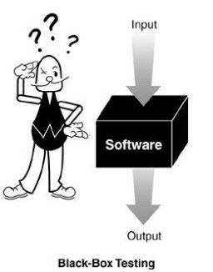
Design of Test Cases
Black-box testing
Characteristics of Black-box testing:
Program is treated as a black box.
Implementation details do not matter.
Requires an end-user perspective.
Test planning can begin early.
Criteria are not precise.

Slide 65
Design of Test Cases
Dynamic black-box testing
Dynamic black-box testing is testing without having an insight into the details of the underlying code.
Dynamic, because the program is running
Black-box, because testing is done without knowledge of how the program is implemented.
Sometimes referred to as behavioral testing.
Requires an executable program and a specification (or at least a user manual).
Test cases are formulated as a set of pairs
E.g., (input, expected output)

Slide 66

Examine the Design Documents & Code
These are static, white box techniques.
Handling these requires some programming expertise.
It is best if the testers know the language in which the software is written.
Consequently, you often find these tests are run by either Programmers with software testers as observers or Software testers with help from the programmers.

Slide 67
Major Problems with These Tests
They are often NOT performed!
These are the hardest to justify to upper management as they are viewed by many as too time consuming.
Some of the problem is the perception that programmers are not productive if they are not generating code.
Note: The tyranny of the LOC metric, Lines of executable code as a measure of productivity!

Slide 68
FORMAL REVIEWS
These are structured processes for doing static, white box testing.
4 elements are required:
1. Identify problems by directing attention to the code, not who wrote it.
2. Setup and follow rules for the review:
- How much code should be examined?
- How long should the review take?
- What is fair game for the review?
3. Prepare and assign duties to people
Moderator, recorder, reader, etc.
4. Write a report.
These are not just “get together and go over code” sessions!

Slide 69
Three approaches
Peer review
Walkthrough
Formal inspection
Informal
Formal
Peer Review Walkthrough Inspection

Slide 70
Typically, different levels of formality identify the kind of formal review:
Peer (or Buddy) Review:
Most informal.
Involves a coder and a few buddies.
Still be sure all 4 elements are present.
Walkthroughs:
Next step in formality.
The programmer works with a small group of ~5 programmers and testers.
Everyone has copies of the code in advance.
A presenter “reads” the code line-by-line, function by function, saying what is done and why it is being done.

Slide 71
Inspections
Most formal of the reviews.
Very highly structured.
The agenda and code to consider is available in advance of the meeting.
The presenter or reader isn’t one of the programmers.
All the other people are inspectors playing different roles. Examples are
- User
- Tester
- Product support person
- Have a moderator and a recorder.

Slide 72

Formal Reviews - Formal inspection
1. Well-defined roles and responsibilities
2. Well-defined steps
Overview
Preparation
Inspection
Rework
Meeting
Follow-up

Slide 73
Formal Reviews
Look for problems and omissions in the code.
May check also to see if the code is written to adhere to pre-specified standards or guidelines.
There is a lot of literature on how formal reviews should be conducted.
Most companies that use them develop their own checklists.

Slide 74
One list to check while doing formal reviews (from the text) :
Data reference errors.
Data declaration errors.
Computation errors.
Comparison errors.
Control flow errors.
Subroutine (or function) parameter errors.
I/O errors
Miscellaneous

Slide 75
Standards and Guidelines
Be careful not confuse these with style considerations.
Indenting rules are about style, not something that affects whether a program is correct or not.
Examples of standards or guidelines:
- Don’t use GOTOs
- Use WHILE loops, instead of DO-WHILE loops except in rare cases.

Slide 76
Why Use Standards or Guidelines
Studies show they increase
Reliability
Readability and, hence, maintainability
Portability
Some contractors require that certain standards be used when developing software for them.
Good example- the government

Slide 77
Overview of the Areas of Dynamic, White Box Testing
Directly test the pieces--- the low-level functions, procedures, subroutines or libraries.
Do top level testing of the completed program, but choose test cases by knowledge of the code.
Directly access variables and state information and force the software to do things.
Measure how much of the code has been tested and be able to adjust your tests to remove redundant test cases and add missing ones.
CAUTION: Be careful to not confuse testing with debugging!
When you try to correct bugs, you are debugging. Normally, programmers debug.

Slide 78
Dynamic, White Box Testing
Control Flow Testing also called structural testing.
Control-flow testing techniques are based on judiciously selecting a set of test paths through the program.
The set of paths chosen is used to achieve a certain measure of testing thoroughness.
E.g., pick enough paths to assure that every source statement is executed as least once.
Techniques here are not limited to just examining the code, but involve directly controlling the software.

Slide 79
Unit test cases
Interface: ensures that information properly flows in and out of the component
local data structures: ensures that data stored temporarily maintains its integrity during execution
boundary conditions: ensures that the component operates properly at boundaries established to limit or restrict processing
independent paths: ensures that all paths in a component have been executed at least once
error-handling paths: ensures that errors are correctly handled

Slide 80
Two Approaches
Running
Running
Test Driver
Tested Module
=main()
call
Tested Module
Test Stub
a special-purpose program to simulate the activity of the missing component
Driver: component that calls component to be tested
Stub: component called by component to be tested

Slide 81
Unit test procedure
Driver
interface
local data structures
boundary conditions
independent paths
error-handling paths
Component
to be tested
Results
Test cases
Stub
Stub
driver and/or stubs must be developed for each unit test

Slide 82
Integration Testing
If components all work individually, why more testing?
Interaction errors cannot be uncovered by unit testing!
(e.g., interface misuse, interface misunderstanding, timing errors)
Integration approaches
Big Bang!!
Incremental
construction
strategy
Versus
Incremental
“builds”
Regression
testing
Notes:
？

Slide 83
Unit Tests vs Integration Tests
Unit tests – Test the pieces of code- the modules (functions, subroutines, etc.)
Integration tests – Test the program or combinations of modules.
Both of these need to be done, but two different strategies are used typically:
Bottom-up Testing
Top-down testing
Note: Mixed strategies can be used, but it is best to consider these separately.

Slide 84
Bottom-up Testing vs Top-down Testing
Bottom-up testing
Test the units as they are completed.
Debug the units.
Integrate some of the units and test the integration.
Debug the integrated units.
Continue until ....???
Note: to test the integrated units, driver code (which later may be thrown away) must be written.

Slide 85
Bottom-up Integration
A
B
C
D
E
F
G
Test E
Test B,E,F
Test A,B,C,D,E,F,G
Test F
Test C
Test G
Test D,G

Slide 86
Pros & cons
Advantage:
- Popular approach
- Is useful when many of low-level components are general-purpose utility routines that are invoked often by others
- Integrated test by component driver
- Test data and test case are created easily
Disadvantage:
- Top-level components are usually the most important but the last to be tested
- Sometimes faults in the top levels reflect faults in design, obviously, these problems should be corrected ASAP
- It is difficult to test a system from bottom up when much of the system’s processing depends on timing

Slide 87
Bottom-up Testing vs Top-down Testing
Top-down Testing
Write a top function first, such as the main function.
Write stubs to handle calls to other functions.
A stub is code that sets variables that must be returned to the calling function and may only just print something such as “In Module A”.
Test and debug the top function.
Replace the stub with actual code.
Test and debug the stub with its calling function(s).
Repeat until ... ???

Slide 88
Top-down integration
A
B
C
D
E
F
G
Test A
Test A,B,C,D,E,F,G
Test A,B,C,D

Slide 89
Pros & cons
Advantage:
- The most important components can be tested early
- Apply to top-down design and code
- Driver programs are not needed in top-down testing
- Logic and structure is clear
Disadvantage:
- A very large number of stubs (a special-purpose program to simulate the activity of the missing component) may be required
- Testing each level’s component individually introduces another difficulty

Slide 90
Modified Top-down integration
A
B
C
D
E
F
G
Test B
Test E
Test A
Test C
Test A,B.C,D
Test F
Test A,B,C,D,E,F,G
Test D
Test G

Slide 91
System Testing
How to test a website
Easiest way to start is by treating the web site as a black box.
Look at a sample website such as www.apple.com to get a sense of the scale of such an endeavor.
Treat each page as a state with hyperlinks as state transitions.

Slide 92
System Testing
“Grey-box” testing
A mixture of white-box and black-box testing.
You stick to black-box testing primarily and supplement it by taking a peek at the HTML to figure out how the website works.
For website testing it is worth looking at the HTML code.
It’s there, easy to look at, why not?
Not looking at the HTML code is wasteful, especially since HTML is such a simple language.
HTML is a tagging language for text and graphics.
To create dynamic web content requires that HTML be supplemented by programming code (e.g., Java applets, ActiveX, VBScript, CGI, Perl).

Slide 93
System Testing
White-box testing
To make sure you find the important bugs you should have some knowledge of the website’s programming:
Dynamic content
Database-driven web pages
Programmatically created web pages
Server performance and loading and security

Slide 94
Software Usability
Eventually a person will interact with a software system.
Software usability is how:
appropriate
functional
effective
that interaction is.
Ergonomics is the science of designing everyday things so that they are easy and functional to use.

Slide 95
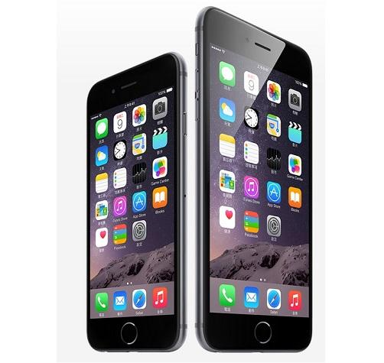
Important traits of a good UI
Follows standards and guidelines
Intuitive
Consistent
Flexible
Comfortable
Correct
Useful

Slide 96
Follows UI standards and guidelines
Macintosh Human Interface Guidelines
http://developer.apple.com/documentation/UserExperience/Conceptual/OSXHIGuidelines/XHIGIntro/chapter_1_section_1.html
Microsoft Windows User Experience
http://msdn2.microsoft.com/en-us/library/aa511258.aspx
These guides detail how software that runs on each platform should look and feel to the user.
When should a check box be used instead of a button?
When is it proper to use information, warning, or critical messages?

Slide 97
Follows UI standards and guidelines (cont’d)
The standards guidelines for a platform should be treated as an addendum to the product specification.
Test cases should be created based on the standards guidelines in addition to the test case created from the product’s specification.
If the development platform does not have a standard, the design team must create usability standards for the software itself.

Slide 98
Intuitive UI
Is the UI clean, unobtrusive, not busy?
Are responses obvious and there when you expect them?
Is the UI organized and laid out well?
Are the inputs acknowledged?
Do the menus go too deep?
Is there excessive functionality?
Is there information overload?
Does the help system really help the user?

Slide 99
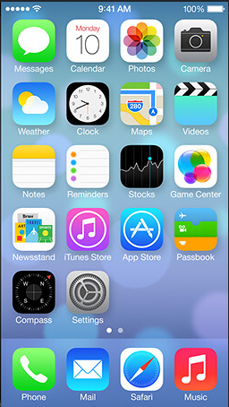
Consistent UI
Shortcut keys and menu selections
F1 should always get you Help in MS Windows.
Different UI paths should have the same F key to execute a feature.
Terminology and naming
Is Find sometimes called Search?
Audience
Consider the success of the UI of the car and ATM.
Placement of buttons such as OK and Cancel
In Mac OS, the OK button is always on the right.
In MS Windows the, the OK button is on the left and Cancel is on the right.

Slide 100
Flexible UI
Users like choices … but not too many.
E.g., MS simple and scientific calculators
Flexible UIs provide:
State jumping
Many alternative ways to achieve the same goal.
State termination and skipping
“If you know your party’s extension enter it at any time”.
Multiple ways to perform I/O
Excel allows many input formats (from keyboard or files) and many output formats (table, graphs, charts).

Slide 101
Comfortable UI
Sounds like a strange notion …
Is the UI appropriate?
Sound effects in a computer game? How about a business application?
Does the UI handle errors well?
If there is no Undo/Redo feature critical operations may fail.
Is the feedback fast enough or too fast?
E.g., waiting for cash to come out of the ATM
Does excessive use cause harm?
E.g., Emacs hand

Slide 102
Correct UI
Marketing differences
Are there extra or missing functions from what the marketing material states?
Language and spelling
Error messages often have spelling mistakes
Bad media (icons, images, sounds, videos) that for with the software UI.
WYSIWYG
E.g., does the printed Adobe Acrobat file look like the one on the screen?

Slide 103
Useful UI
When testing a UI feature, ask if the feature you see actually contributes to the software’s value.
Many applets have useless features
Useless UI features waste time for the user, developer, and tester.

Slide 104
What is Quality?
Quality – developed product meets it’s specification
Problems:
• Development organization has requirements exceeding customer's specifications (added cost of product development)
• Certain quality characteristics can not be specified in unambiguous terms (i.e. maintainability)
• Even if the product conforms to it’s specifications, users may not consider it to be a quality product (because users may not be involved in the development of the requirements)

Slide 105
What is Quality Management?
Quality Management – ensuring that required level of product quality is achieved
• Defining procedures and standards
• Applying procedures and standards to the product and process
• Checking that procedures are followed
• Collecting and analyzing various quality data
Problems:
• Intangible aspects of software quality can’t be standardized (i.e elegance and readability)

Slide 106
What are SQA, SQP, SQC, and SQM?
SQA includes all 4 elements…
Software Quality Assurance – establishment of network of organizational procedures and standards leading to high-quality software
Software Quality Planning – selection of appropriate procedures and standards from this framework and adaptation of these to specific software project
Software Quality Control – definition and enactment of processes that ensure that project quality procedures and standards are being followed by the software development team
Software Quality Metrics – collecting and analyzing quality data to predict and control quality of the software product being developed

Slide 107
Software Development Cycle
Software Development Phase
• Software requirements
• Preliminary Design
• Detailed Design
• Code
• Unit Test
• Software integration
• Software Component Test
• Software System Test
• Maintenance and Support
End product
• SRS, IRS
• SDD, PQT/FAT/SAT Plans & Proc.’s, ICD, IDD
• PDL, User Manuals
• Code, UT Plan & Proc.’s
• UT Results
• VDD
• PQT Report
• FAT & SAT Reports
• updates

Slide 108
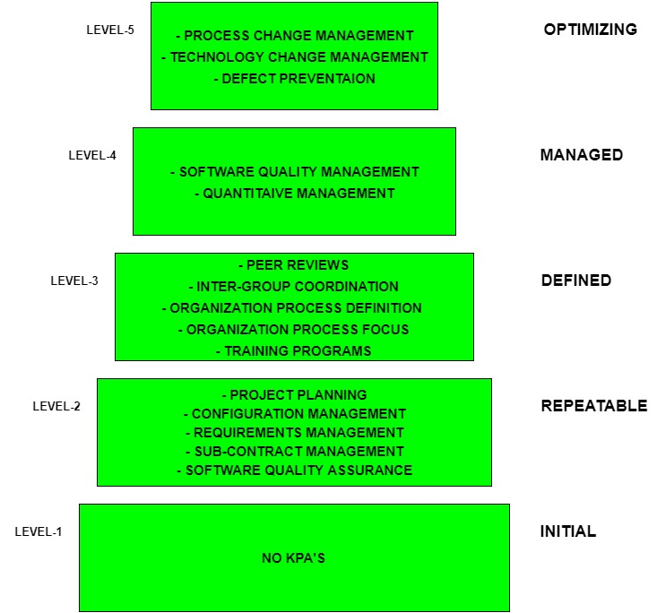
Capability Maturity Model KPA’s

Slide 109
Capability Maturity Model KPA’s
Level-1: Initial –
No KPA’s defined.
Processes followed are adhoc and immature and are not well defined.
Unstable environment for software development.
No basis for predicting product quality, time for completion, etc.

Slide 110
Capability Maturity Model KPA’s
Level-2: Repeatable –
Focuses on establishing basic project management policies.
Experience with earlier projects is used for managing new similar natured projects.
Project Planning- It includes defining resources required, goals, constraints, etc. for the project. It presents a detailed plan to be followed systematically for successful completion of a good quality software.
Configuration Management- The focus is on maintaining the performance of the software product, including all its components, for the entire lifecycle.
Requirements Management- It includes the management of customer reviews and feedback which result in some changes in the requirement set. It also consists of accommodation of those modified requirements.
Subcontract Management- It focuses on the effective management of qualified software contractors i.e. it manages the parts of the software which are developed by third parties.
Software Quality Assurance- It guarantees a good quality software product by following certain rules and quality standard guidelines while development.

Slide 111
Capability Maturity Model KPA’s
Level-3: Defined –
At this level, documentation of the standard guidelines and procedures takes place.
It is a well defined integrated set of project specific software engineering and management processes.
Peer Reviews- In this method, defects are removed by using a number of review methods like walkthroughs, inspections, buddy checks, etc.
Intergroup Coordination- It consists of planned interactions between different development teams to ensure efficient and proper fulfillment of customer needs.
Organization Process Definition- It’s key focus is on the development and maintenance of the standard development processes.
Organization Process Focus- It includes activities and practices that should be followed to improve the process capabilities of an organization.
Training Programs- It focuses on the enhancement of knowledge and skills of the team members including the developers and ensuring an increase in work efficiency.

Slide 112
Capability Maturity Model KPA’s
Level-4: Managed –
At this stage, quantitative quality goals are set for the organization for software products as well as software processes.
The measurements made help the organization to predict the product and process quality within some limits defined quantitatively.
Software Quality Management- It includes the establishment of plans and strategies to develop a quantitative analysis and understanding of the product’s quality.
Quantitative Management- It focuses on controlling the project performance in a quantitative manner.

Slide 113
Capability Maturity Model KPA’s
Level-5: Optimizing –
This is the highest level of process maturity in CMM and focuses on continuous process improvement in the organization using quantitative feedback.
Use of new tools, techniques and evaluation of software processes is done to prevent recurrence of known defects.
Process Change Management- Its focus is on the continuous improvement of organization’s software processes to improve productivity, quality and cycle time for the software product.
Technology Change Management- It consists of identification and use of new technologies to improve product quality and decrease the product development time.
Defect Prevention- It focuses on identification of causes of defects and to prevent them from recurring in future projects by improving project defined process.

Slide 114
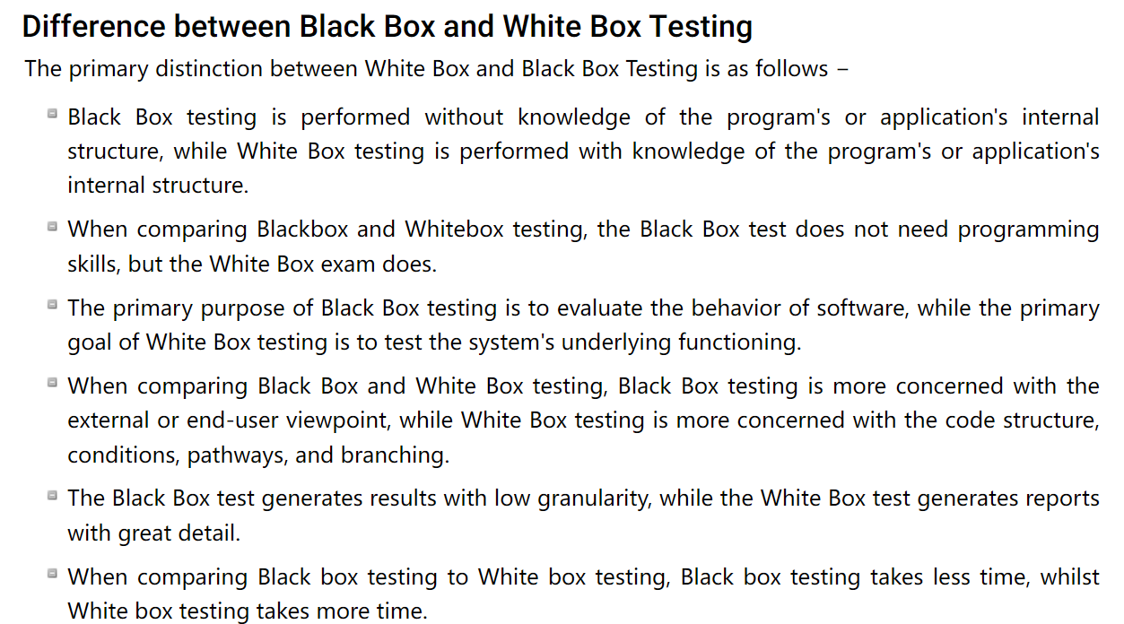
Please explain the difference between white box testing and black box testing

Slide 115
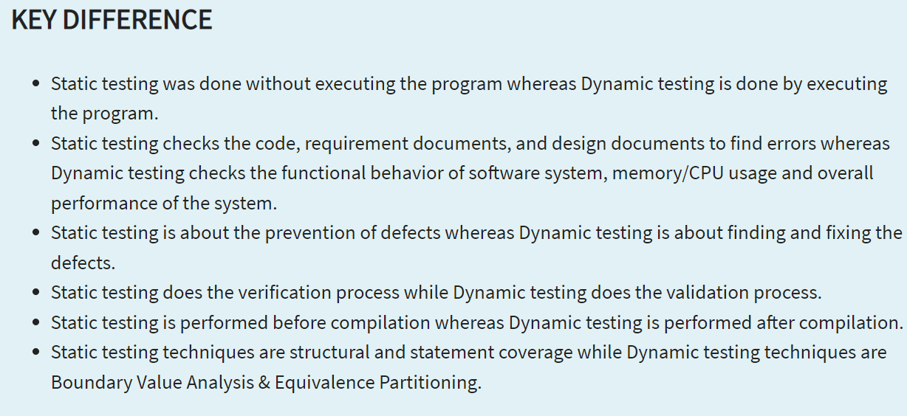
Please explain the difference between static testing and dynamic testing

Slide 116
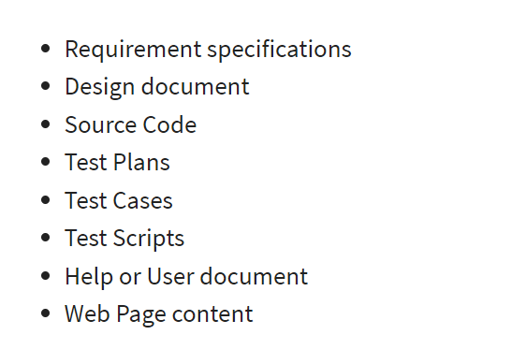
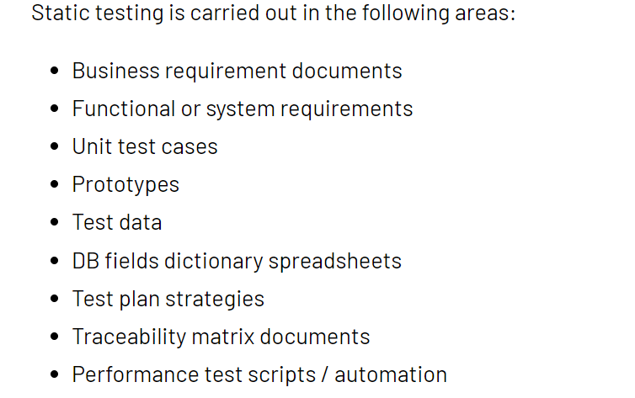
Could you provide the list of document or content that static testing can test? And provide the different levels of static testing.

